Slide 1
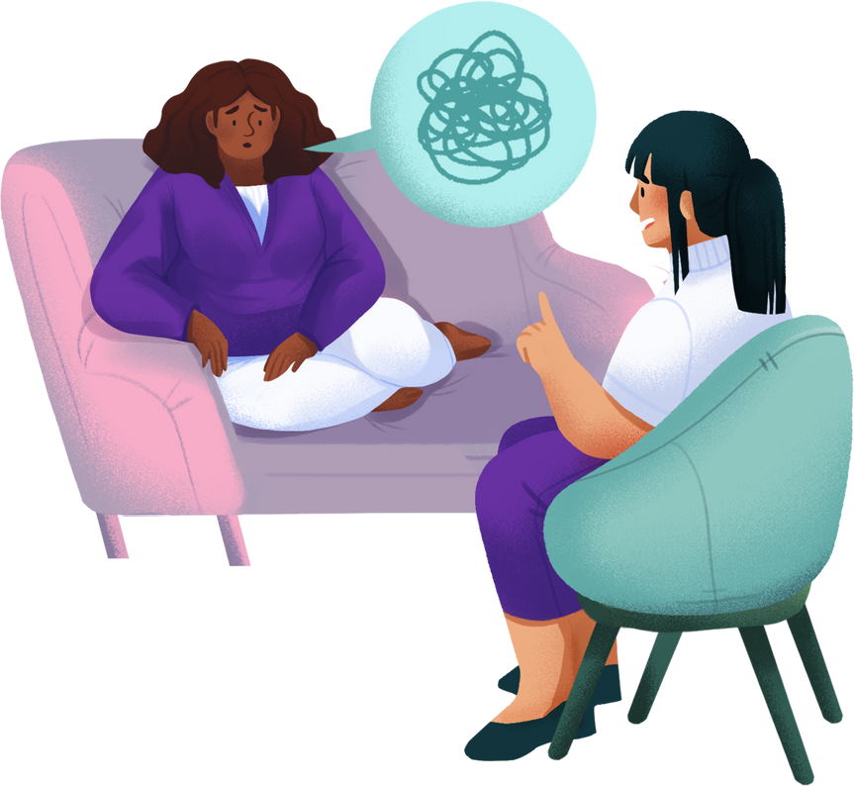
AI-POWERED MENTAL HEALTH & WELL-BEING ASSISTANT
ENHANCING WORK-LIFE BALANCE THROUGH AI & CHATBOTS
Team : NaN

Slide 2
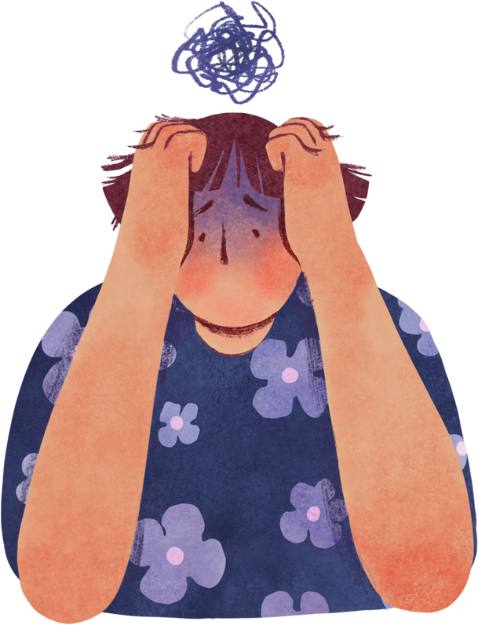
THE PROBLEM
Why Mental Well-being Matters
Rising stress levels
Work-life imbalance
Limited access to personalized mental health support

Slide 3
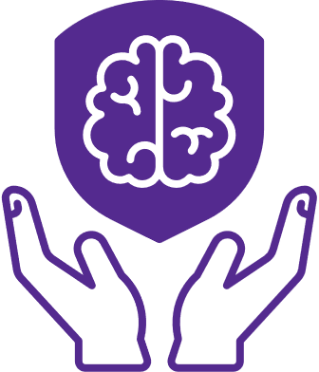
OUR SOLUTION
AI-powered well-being assistant
Tracks productivity, social activity, self-care & stress
AI chatbot for real-time support with voice chat integration
Smart task scheduling & time optimization

Slide 4
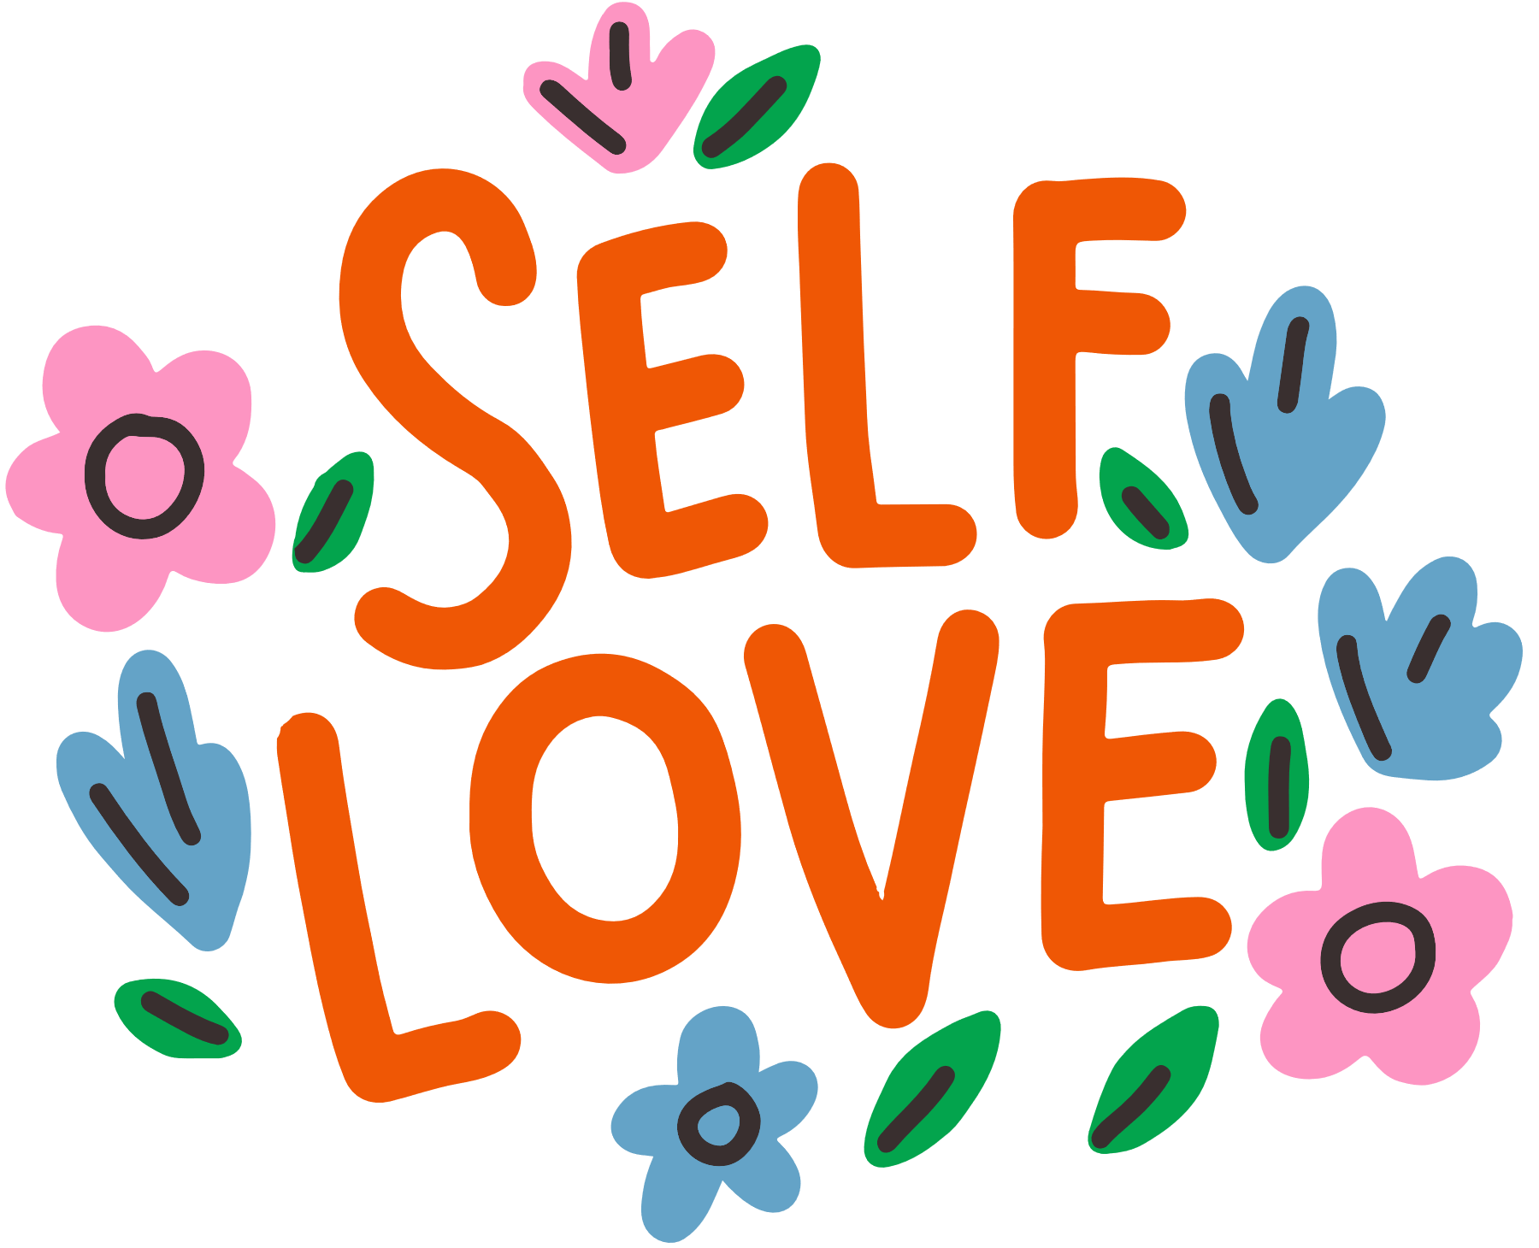
KEY FEATURES
Daily Well-being Scores (Social, Work, Self-Care, Stress)
Chatbot for Mental Health Advice
Predictive Scheduling & Task Optimization
Personalized AI Insights & Recommendations
"We need to understand what happens to us inside"

Slide 5
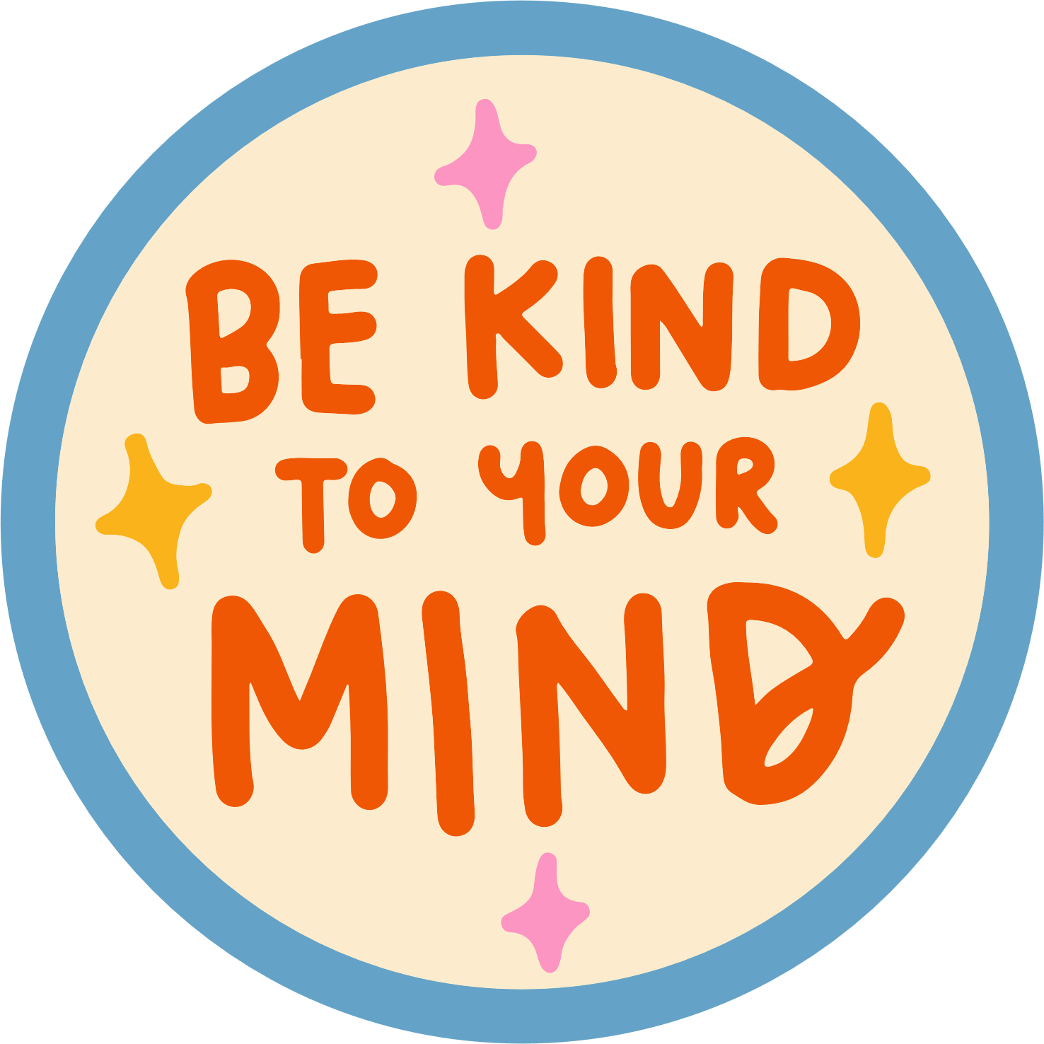
HOW DOES IT WORK?
"Access to free psychological help"
AI analyzes your responses (Social, Work, Self-care, Stress)
Machine Learning predicts cognitive overload & engagement needs
Reinforcement Learning optimizes time management
AI Chatbot offers mental health support

Slide 6
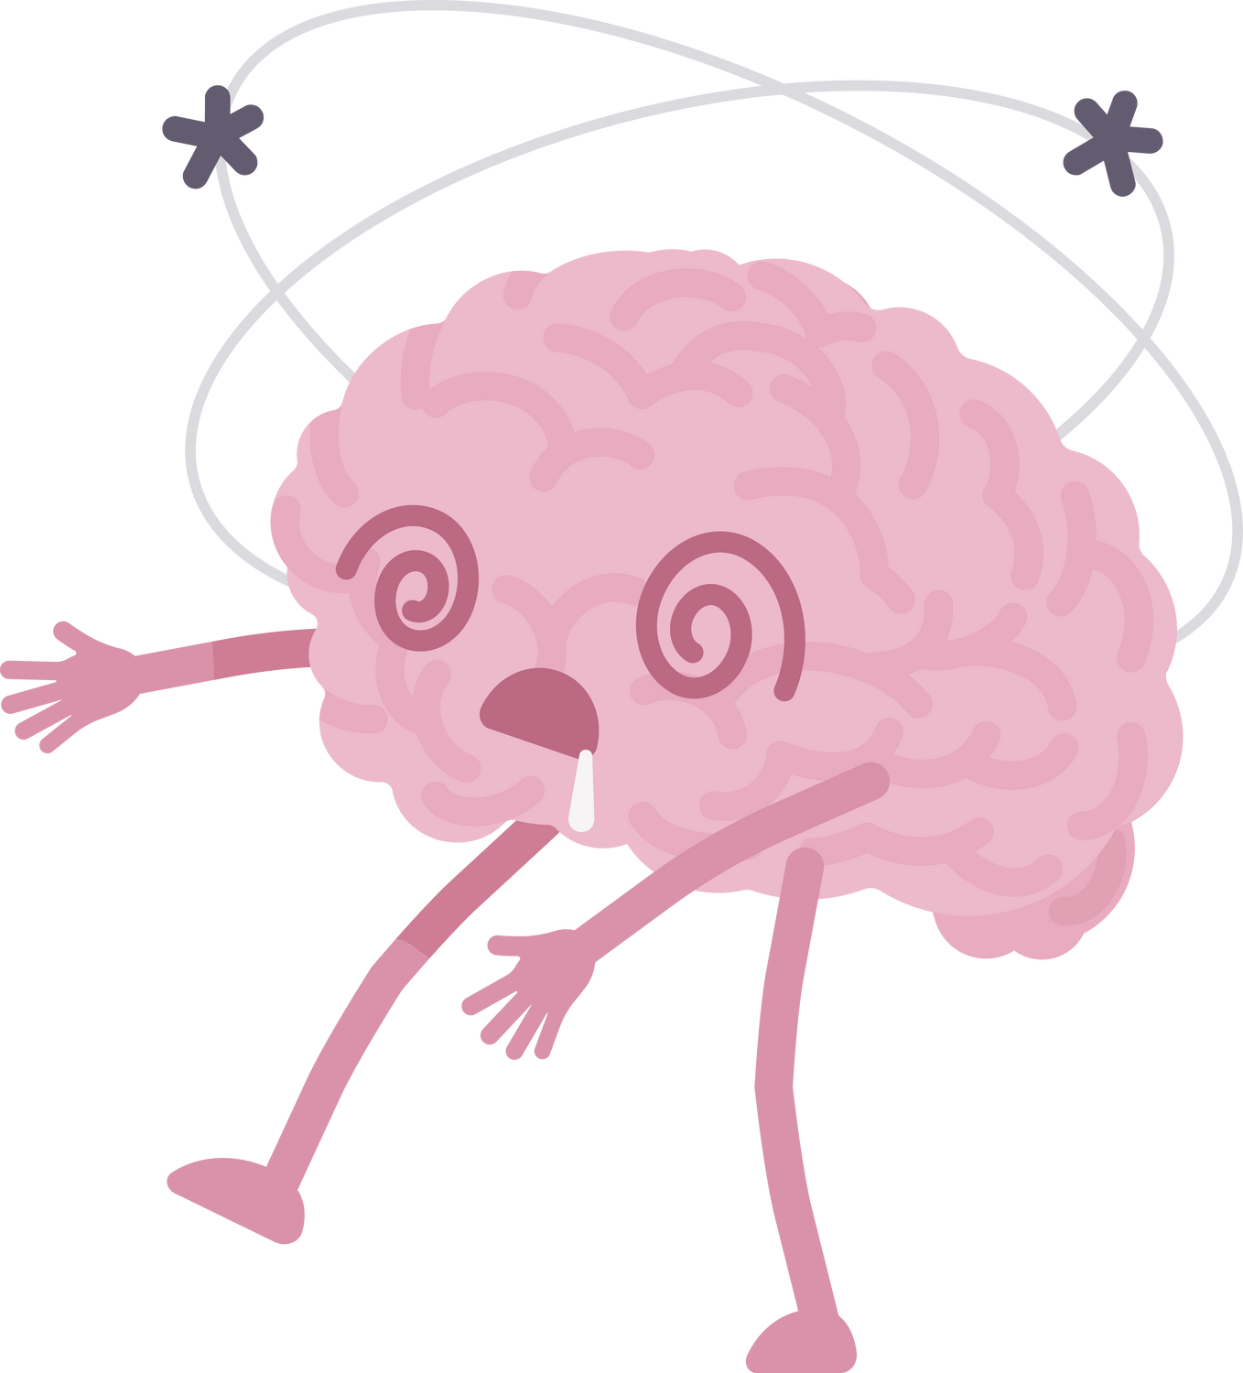
RESULTS & DISCUSSIONS
"Anxiety is a real problem in our society"
Example: Daily Scores (Social Activity Score: 57, Work Productivity Score: 83, Self Care Score: 53, Stress Impact Score: 71)
AI Suggests:
“Schedule regular catch up with friends and colleagues”
“Join community groups or social activities”
“Engage more in team activities at work”

Slide 7
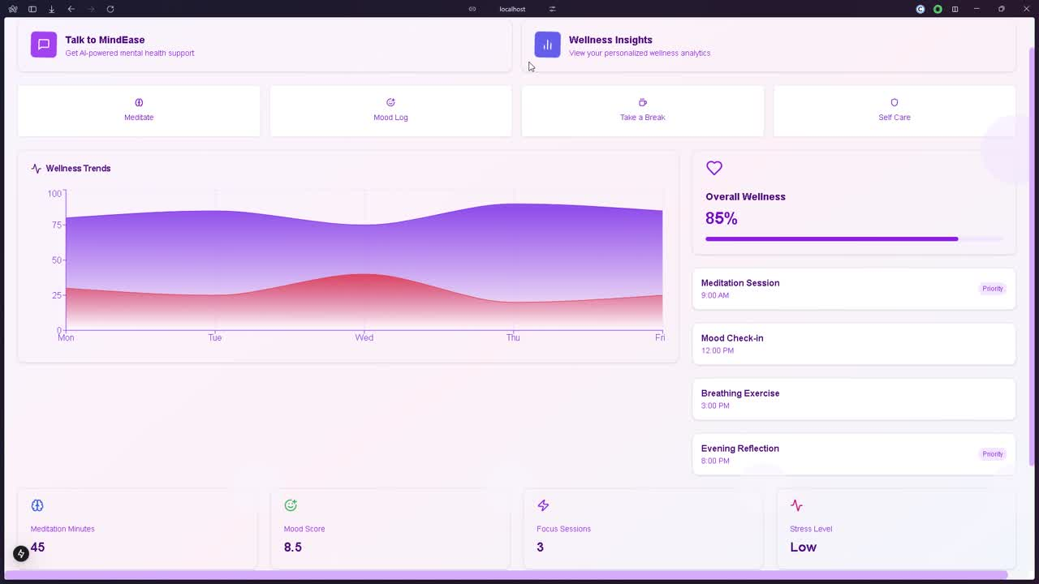
DEMONSTRATION AND WORKING

Slide 8

FUTURE ROADMAP
Smart Calendar Sync (Stress-based Rescheduling)
Chatbot on WhatsApp, Telegram, Slack
Gamification (Rewards for Well-being Tracking)
Wearable Integration (Apple Watch, Fitbit)

Slide 9

CONCLUSION
Empowering Users with AI & Mental Health Support
Making work-life balance stress-free with AI-driven insights

Slide 10
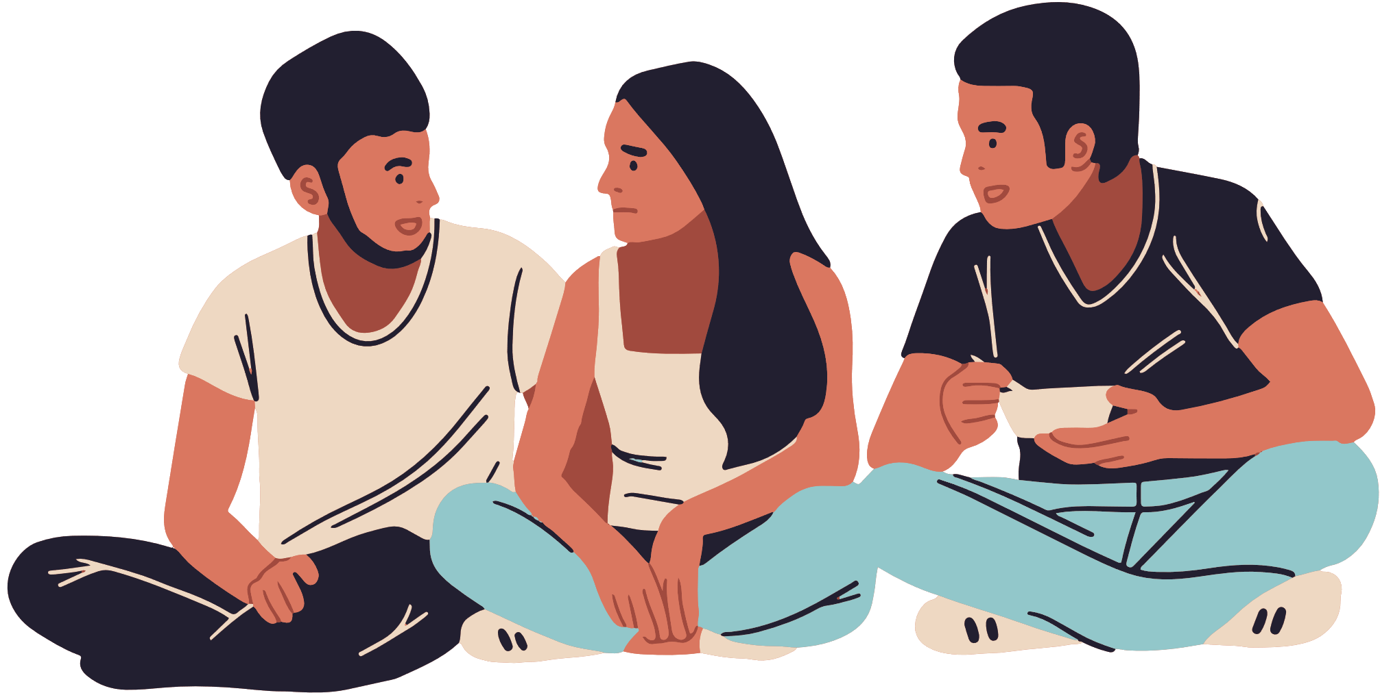
THANK YOU

